Slide 1
TADS - Text perturbation Attack and Defense with Synonym replacement
https://github.com/Lakri99/Text_perturbation_attack
Machine learning for cyber security
Team AJL

Slide 2
Problem Statement:
Generating input perturbation for text data and identifying it through a defense
model for text classification task
Objectives:
Develop methods to perturb text input in order to reverse the decision of the text classification model
The perturbed text input is semantically similar to original text input
Train a model to classify if the given text input has been perturbed or not

Slide 3
Approach for the attack model:
Train a LSTM classifier for sentiment analysis on IMDB dataset
Identify the important words that influence the classification decision using a black box method
Rank the important words
Replace the ranked words one by one with synonyms / word embeddings until the decision flips

Slide 4
Approach for the defense model:
Train a model that classifies if the given sentence has been perturbed or not
Create a dataset using the perturbed text from the attack model
Use the created dataset to train the model

Slide 5
Base model
Trained a LSTM model for sentiment Analysis on IMDB. The model has an accuracy of about 87% on the test set

Slide 6
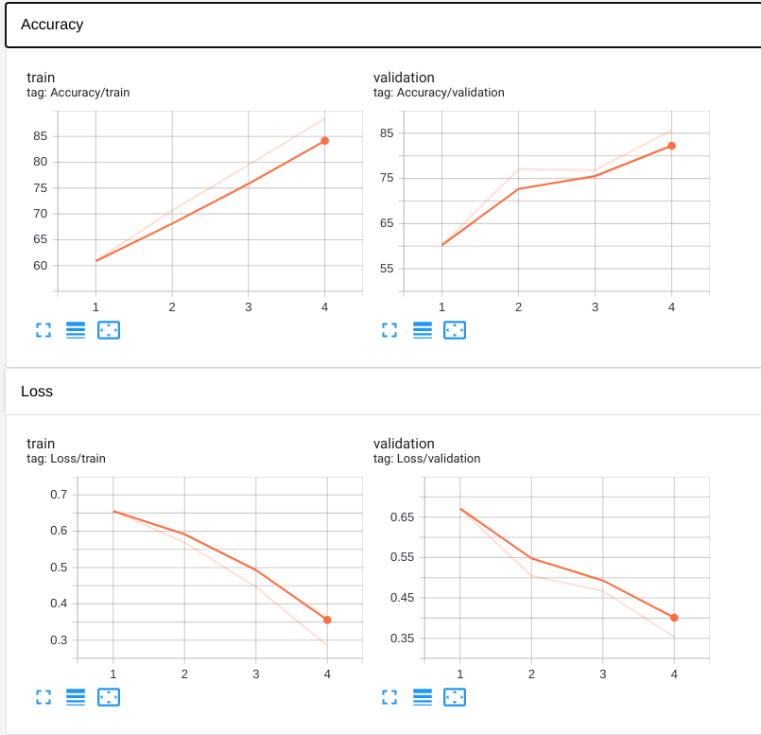
Model Performance

Slide 7
Text perturbation attack model
Ranking based on word importance:
Example sentence: ‘I wish I knew what to make of a movie like this. It seems to be divided into two parts -- action sequences and personal dramas ashore. It follows Ashton Kutsher ………….we don't learn much about that. We don't really learn much about anything. The film devolves into a succession of visual displays and not too much else. A disappointment.’
Original output logit: 0.0899
Logit output without ‘wish’ : 0.0796
Logit output without ‘knew’ : 0.0831
Logit output without ‘learn’ : 0.0633
Logit output without ‘disappointment’ : 0.3023
word importance ranking: [('disappointment', 0.21241310238838196), ('elements', 0.05572117865085602),
('displays', 0.03151237219572067), ('learn', 0.026578865945339203), ('succession', 0.022550858557224274) …]

Slide 8
Similar word generation
Wordnet Synsets with pos restrictions:
Example:
Word: ‘cheap' pos: 'ADJ'
Synset list: ['brassy', 'crummy', 'chintzy', 'garish', 'sleazy', 'tatty', 'gimcrack', 'tinny', 'flash', 'bum', 'flashy', 'punk', 'meretricious', 'cheesy', 'tawdry', 'chinchy', 'gaudy', 'loud', 'trashy', 'inexpensive', 'cheap', 'tacky']
Word: ‘film’ pos: ‘NOUN’
Synset list: ['cinema', 'motion picture', 'motion-picture show', 'moving-picture show', 'moving picture', 'pic', 'flick', 'plastic film', 'movie', 'photographic film', 'celluloid', 'picture show', 'picture']

Slide 9
Similar word generation
Glove embedding
Example:
divided ----> split
succession ----> dynastic
disappointment ----> frustration
learn ----> understand
film ----> movie

Slide 10
Word embedding Constraint
The modified reviews are constraint to >= threshold similarity score in BERT sentence embedding space.
All other combinations of similar words are ignored
Example:
A touching movie . It is full of emotions and marvellous acting . I could have sat through it a second time .
A touching movie . It is full of emotions and howling acting . I could have sat through it a second time .

Slide 11
Example of Modified text
Original Text:
This is a great movie . Too bad it is not available on home video .
Modified text:
This is a greatest movie . Too worse it is not provided on home video .

Slide 12
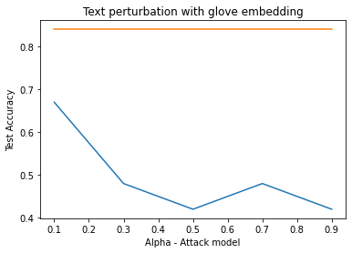
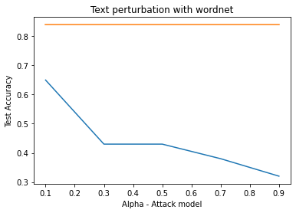

Performance degradation on Test data subset

Slide 13
Text perturbation defense model
Created a dataset consisting of original text and corresponding perturbed text samples using the synonym replacement method mentioned before
The dataset consists of 80k samples totally
70% of this data is used as training data and 30% is used as test data
 | Positive review | Negative review
Original text | 20k | 20k
Perturbed text | 20k | 20k

Slide 14
Model architecture
We trained two models using the text perturbation dataset
The first model is an LSTM classifier and the second model is a pre-trained BERT model particularly ‘bert-base-uncased’ which is then fine tuned for this task

Slide 15
Results
Model | Test Accuracy
LSTM classifier | 96.76%
Bert-based classifier | 97.14%

Slide 16
Conclusion
Models
Base model: LSTM based Sentiment classifier trained on IMDB reviews dataset
Attack method: Replacement of important words with synonyms from WordNet, GloVe
Defence method: LSTM-classifier, BERT-based classifier
Word replacement with sentence embedding as a constraint preserves the overall semantics of perturbed text similar to original text
Significant performance degradation of the model after the text perturbation
Defense method to identify the perturbed text

Slide 17
References
https://www.aclweb.org/anthology/2020.emnlp-main.500/
https://github.com/LinyangLee/BERT-Attack
GitHub - jind11/TextFooler: A Model for Natural Language Attack on Text Classification and Inference

